Slide 1
Swift Rails - Activity Diagram
Document Owner:Harsha,Sankeerth Contibutor:Priya,shashank Peer-Reviewer:Supraja

Slide 2
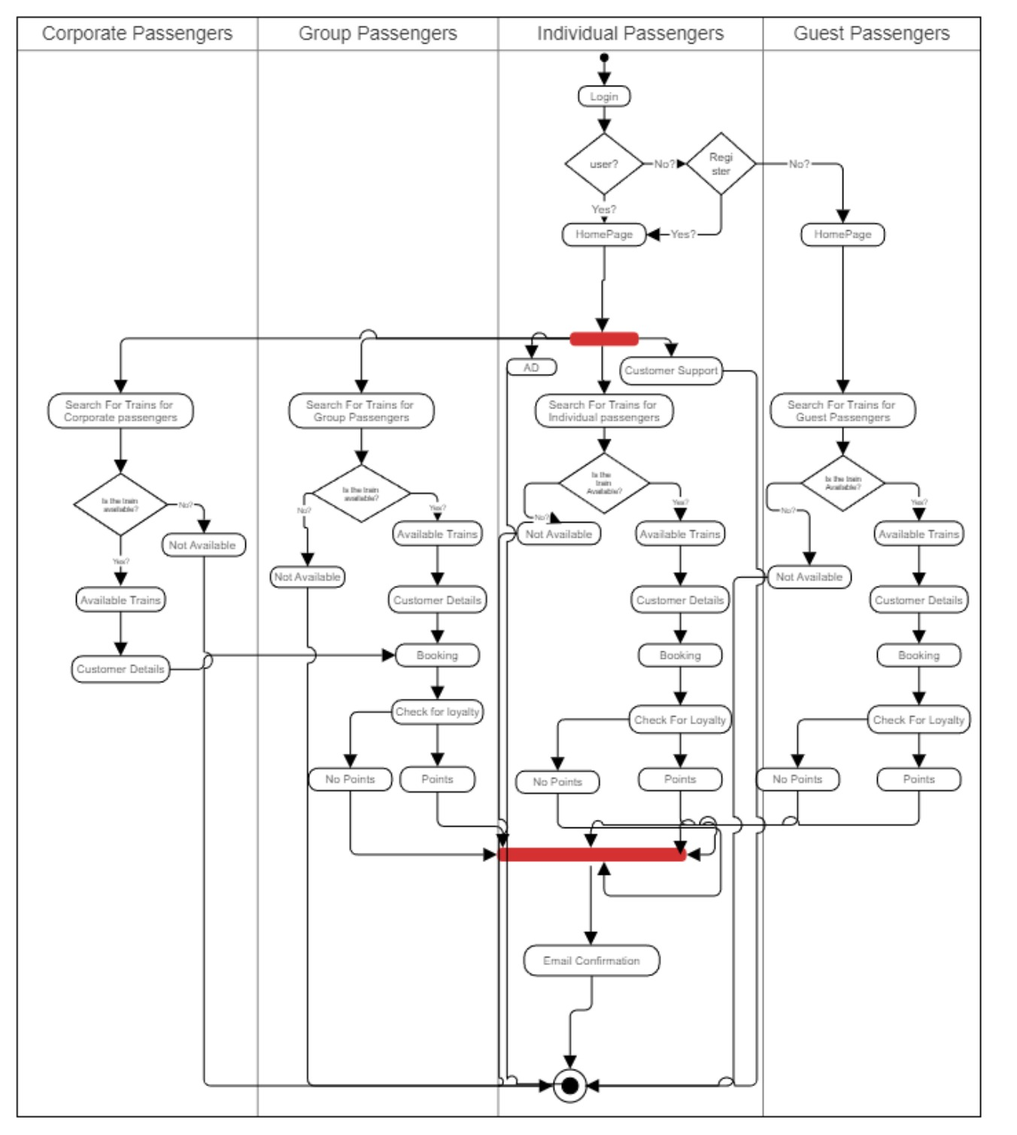
start
END

